Slide 1

CSCI-5408 Sales Data Case Study Group 4
Sasidharan Srikrishna (B00835818)
Bhalerao Ketan (B00839791)
Rachakonda Sumith Sai (B00851825)

Slide 2
Agenda
A closer look: Sales Dataset
Summary Data
Snowflake Schema
Cognos BI Live Demo
Future Sales Prediction using Neural Networks

Slide 3
A closer look: Given Dataset
Dataset Domain: Automobile Sales
Number of Rows: 2823
Number of Columns: 25
Meaning of each row: A customer X ordered product P over a specific date. Moreover, the customer are grouped based on different regions.
Cleaned Columns: ORDERDATE, MONTH, QTR_ID, COUNTRY, TERRITORY.
Transformed Columns: DEALSIZE, MONTH, QTR_ID

Slide 4
Summary Data
There are 307 unique orders.
There are 109 unique products.
There are 92 unique customers from 19 different countries.
There are 7 unique order status.
The data has been stored for the years from 2003 to 2005.
Every order line can be a SMALL, MEDIUM or LARGE deal based on the sales value.

Slide 5
Data warehousing​
Used to analyze data models from different sources.
Multidimensional data model

Slide 6
OLAP Operations
Drill down – Moving down in the hierarchy, adding new dimensions.​
Roll Up – Moving up in the hierarchy, Reducing dimensions (In Cognos Drill up) .​
Dice – Selecting two or more dimension to visualize.​
Slice – Select single dimension from OLAP.
Pivot – Rotates the current view to get a new view of the representation.​

Slide 7
Schemas and Tables​
Star schema and Snowflake schema .​
FACT Table - Numeric measurements of a given business activity.​
DIMENSION Table - Additional information about the fact.​

Slide 8
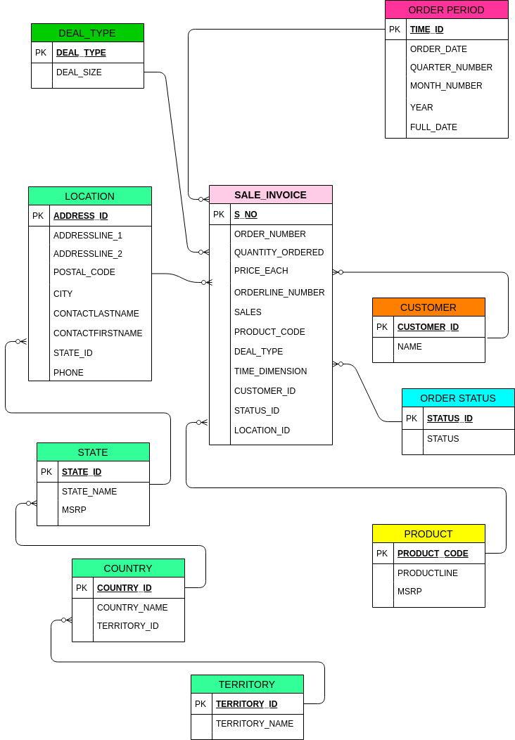
The Snowflake Schema

Slide 9
Visualizations using Cognos BI
Cognos BI Demo

Slide 10
Future Sales Prediction using Neural Network
We have trained a neural network in order to predict sales for 2020-2022 (upcoming 3 years).
It was trained on Tensorflow (Machine learning library of Google)
The prediction error is -30 to +30 dollars.
The graphs have been plotted on Cognos.

Slide 11
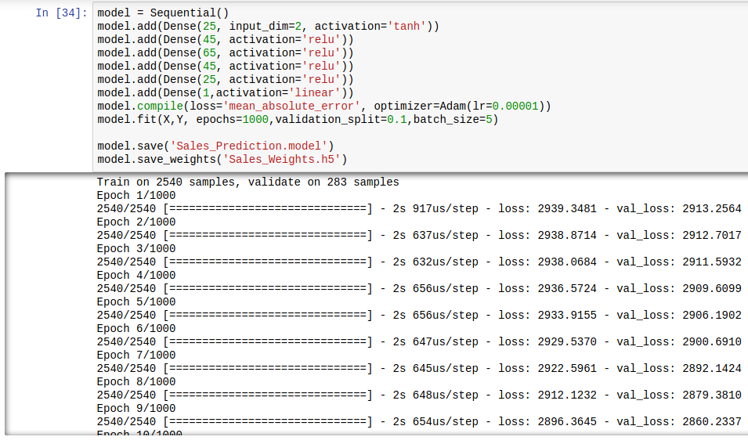
Screenshot of Neural Network training

Slide 12
THANK YOU

Slide 13
Reference
[1] “OLAP Operations in DBMS - GeeksforGeeks,” GeeksforGeeks, 21-Jan-2019. [Online]. Available: https://www.geeksforgeeks.org/olap-operations-in-dbms/. [Accessed: 24-Mar-2020].

